Slide 1

DEPARTMENT OF ARTIFICIAL INTELLIGENCE AND DATA SCIENCE
Vision
To impart international quality education, promote collaborative research and graduate industry-ready engineers in the domain of Artificial Intelligence and Data Science to serve the society.

Slide 2
Operator overloading
Operator Overloading means giving additional meaning beyond their predefined operational meaning.
For example operator +
is used to add two integers as well as
join two strings and
merge two lists.
It is achievable because ‘+’ operator is overloaded by int class and str class.

Slide 3
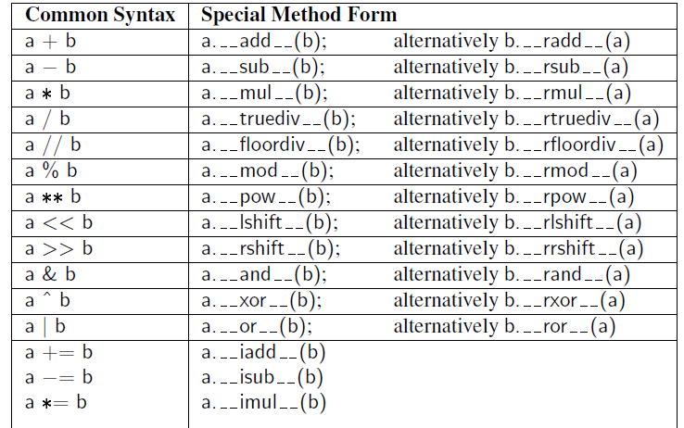

Slide 4
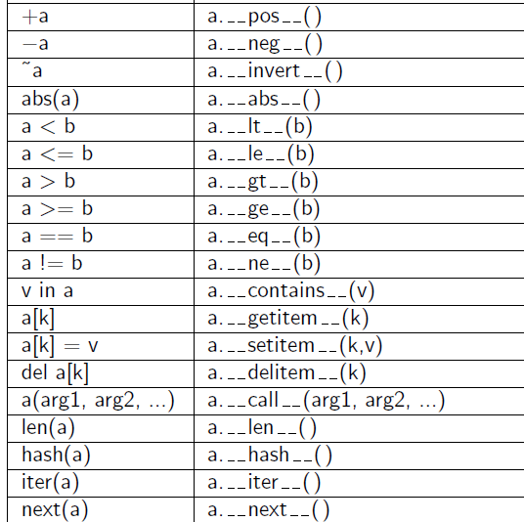

Slide 5
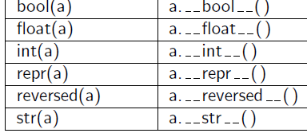

Slide 6
#operator overloading
print(1 + 2)
# concatenate two strings
print("RIT"+"IANS")
# Product two numbers
print(3 * 4)
# Repeat the String
print("RIT"*4)

Slide 7
# Python Program to overload an binary + operator
class A:
def __init__(self, a):
self.a = a
# adding two objects
def __add__(self, o):
return self.a + o.a
ob1 = A(1)
ob2 = A(2)
ob3 = A(“RIT")
ob4 = A(“IANS")
print(ob1 + ob2) # output ?
print(ob3 + ob4) # output ?

Slide 8
Python Program to perform addition of two complex numbers using binary + operator overloading.
class Complex:
def __init__(self, real, imaginary):
self. real = real
self. imaginary = imaginary
# adding two objects by operator overloading method
def __add__(self, other):
return self. real + other. real, self. imaginary + other. imaginary
Ob1 = complex(1, 2)
Ob2 = complex(2, 3)
Ob3 = Ob1 + Ob2
print(Ob3)

Slide 9
# Python program to overload a comparison operators
class A:
def __init__(self, a):
self.a = a
def __gt__(self, other):
if(self.a>other.a):
return True
else:
return False
ob1 = A(2)
ob2 = A(3)
if(ob1>ob2):
print("ob1 is greater than ob2")
else:
print("ob2 is greater than ob1")

Slide 10
Practice
Python program to overload equality and less than operators
Python program to overload not equality and greater than operators

Slide 11
Multi-dimensional vector
v = Vector(5) # construct five-dimensional <0, 0, 0, 0, 0>
v[1] = 23 # <0, 23, 0, 0, 0> (based on use of setitem )
v[−1] = 45 # <0, 23, 0, 0, 45> (also via setitem )
print(v[4]) # print 45 (via getitem )
u = v + v # <0, 46, 0, 0, 90> (via add )
print(u) # print <0, 46, 0, 0, 90>

Slide 12
EX: Operator overloading-Multi-dimensional vector class
import collections
class Vector:
"""Represent a vector in a multidimensional space."""
def __init__(self, d):
if isinstance(d, int):
self._coords = [0] * d
else:
try: # we test if param is iterable
self._coords = [val for val in d]
except TypeError:
raise TypeError('invalid parameter type')

Slide 13
def __len__(self):
"""Return the dimension of the vector."""
return len(self._coords)
def __getitem__(self, j):
"""Return jth coordinate of vector."""
return self._coords[j]
def __setitem__(self, j, val):
"""Set jth coordinate of vector to given value."""
self._coords[j] = val

Slide 14
def __add__(self, other):
"""Return sum of two vectors."""
if len(self) != len(other): # relies on __len__ method
raise ValueError('dimensions must agree')
result = Vector(len(self)) # start with vector of zeros
for j in range(len(self)):
result[j] = self[j] + other[j]
return result
def __eq__(self, other):
"""Return True if vector has same coordinates as other."""
return self._coords == other._coords

Slide 15
def __ne__(self, other):
"""Return True if vector differs from other."""
return not self == other # rely on existing __eq__ definition
def __str__(self):
"""Produce string representation of vector."""
return '<' + str(self._coords)[1:-1] + '>' # adapt list representation
def __neg__(self):
"""Return copy of vector with all coordinates negated."""
result = Vector(len(self)) # start with vector of zeros
for j in range(len(self)):
result[j] = -self[j]
return result

Slide 16
def __lt__(self, other):
"""Compare vectors based on lexicographical order."""
if len(self) != len(other):
raise ValueError('dimensions must agree')
return self._coords < other._coords
def __le__(self, other):
"""Compare vectors based on lexicographical order."""
if len(self) != len(other):
raise ValueError('dimensions must agree')
return self._coords <= other._coords

Slide 17
v = Vector(5) # construct five-dimensional <0, 0, 0, 0, 0>
v[1] = 23 # <0, 23, 0, 0, 0> (based on use of setitem )
v[−1] = 45 # <0, 23, 0, 0, 45> (also via setitem )
print(v[4]) # print 45 (via getitem )
u = v + v # <0, 46, 0, 0, 90> (via add )
print(u) # print <0, 46, 0, 0, 90>

Slide 18
Polymorphism
Polymorphism means the same function name with different arguments to perform different task
def add(x, y):
return x + y
def add(x, y, z ):
return x + y+z
# Driver code
print(add(2, 3))
print(add(2, 3, 4))

Slide 19
Polymorphism
# Python program to demonstrate in-built polymorphic functions
# len() being used for a string
print(len("geeks"))
# len() being used for a list
print(len([10, 20, 30]))

Slide 20
Polymorphism
Polymorphism with class methods
class India():
def capital(self):
print("New Delhi is the capital of India.")
def language(self):
print("Hindi is the most widely spoken language of India.")
def type(self):
print("India is a developing country.")

Slide 21
Polymorphism
class USA():
def capital(self):
print("Washington, D.C. is the capital of USA.")
def language(self):
print("English is the primary language of USA.")
def type(self):
print("USA is a developed country.")
obj_ind = India()
obj_usa = USA()
for country in (obj_ind, obj_usa):
country.capital()
country.language()
country.type()

Slide 22
Practice
Practice
Implement polymorphism to find the area of circle, square, and rectangle.
Create the two classes ‘Tomato’ and ‘Apple’ which contains the methods type() and color(), each of which is print the type and color of the tomato and apple.

Slide 23
class Tomato(): #tomato class
def type(self):
print(" Tomato is a Vegetable")
def color(self):
print(“color is Red")
class Apple(): #apple class
def type(self):
print(“Apple is a Fruit")
def color(self):
print(“Apple is Red")
obj_tomato = Tomato()
obj_tomato.type()
obj_tomato.color()
obj_apple = Apple()
obj_apple.type()
obj_apple.color()

Slide 24
References
https://www.geeksforgeeks.org/python-oops-concepts/

